Slide 1

Query 3 with Pig

Slide 2


What we know so far…
#1 used drug = Oxycodone
California one of the most affected states

Slide 3



Distribution By City
Where?

Slide 4
Code (1)
data = LOAD '/user/amarro15/practice/arcos_all_washpost1.tsv' AS (reporter_dea_no:chararray, reporter_bus_act:chararray, reporter_name:chararray, reporter_addl_co_info:chararray, reporter_address1:chararray, reporter_address2:chararray, reporter_city:chararray, reporter_state:chararray, reporter_zip:chararray, reporter_county:chararray, buyer_dea_no:chararray, buyer_bus_act:chararray, buyer_name:chararray, buyer_addl_co_info:chararray, order_form_no:chararray, correction_no:chararray, strength:int, transaction_date:chararray, calc_base_wt_in_gm:double, dosage_unit:int, transaction_id:chararray, product_name:chararray, ingredient_name:chararray, measure:chararray, ….and so on

Slide 5
Code (2)
drug_data = FILTER data BY drug_name == 'OXYCODONE';
california_subset = FILTER drug_data BY buyer_state == 'CA' AND reporter_bus_act == 'DISTRIBUTOR';
grouped = GROUP california_subset BY reporter_city;
totals = FOREACH grouped GENERATE group, SUM(california_subset.quantity) AS city_count;

Slide 6
Code (3)
sorted = ORDER totals BY city_count DESC;
top_ten = LIMIT sorted 100;
DUMP top_ten;
STORE top_ten INTO 'output/top_ten' USING PigStorage(',');

Slide 7
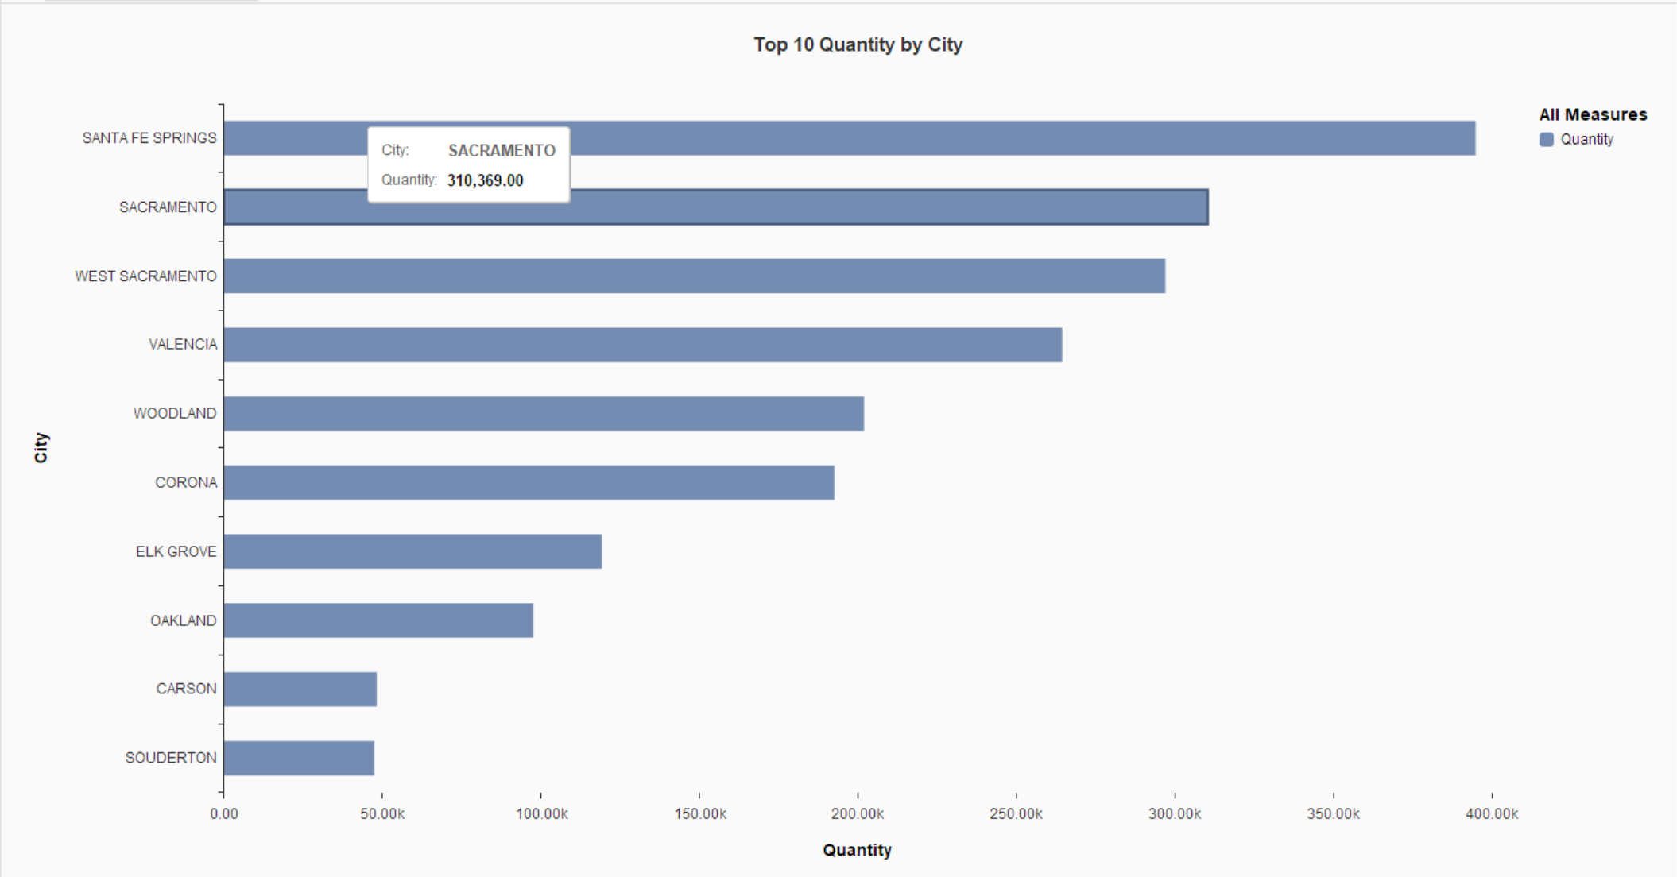

Slide 8
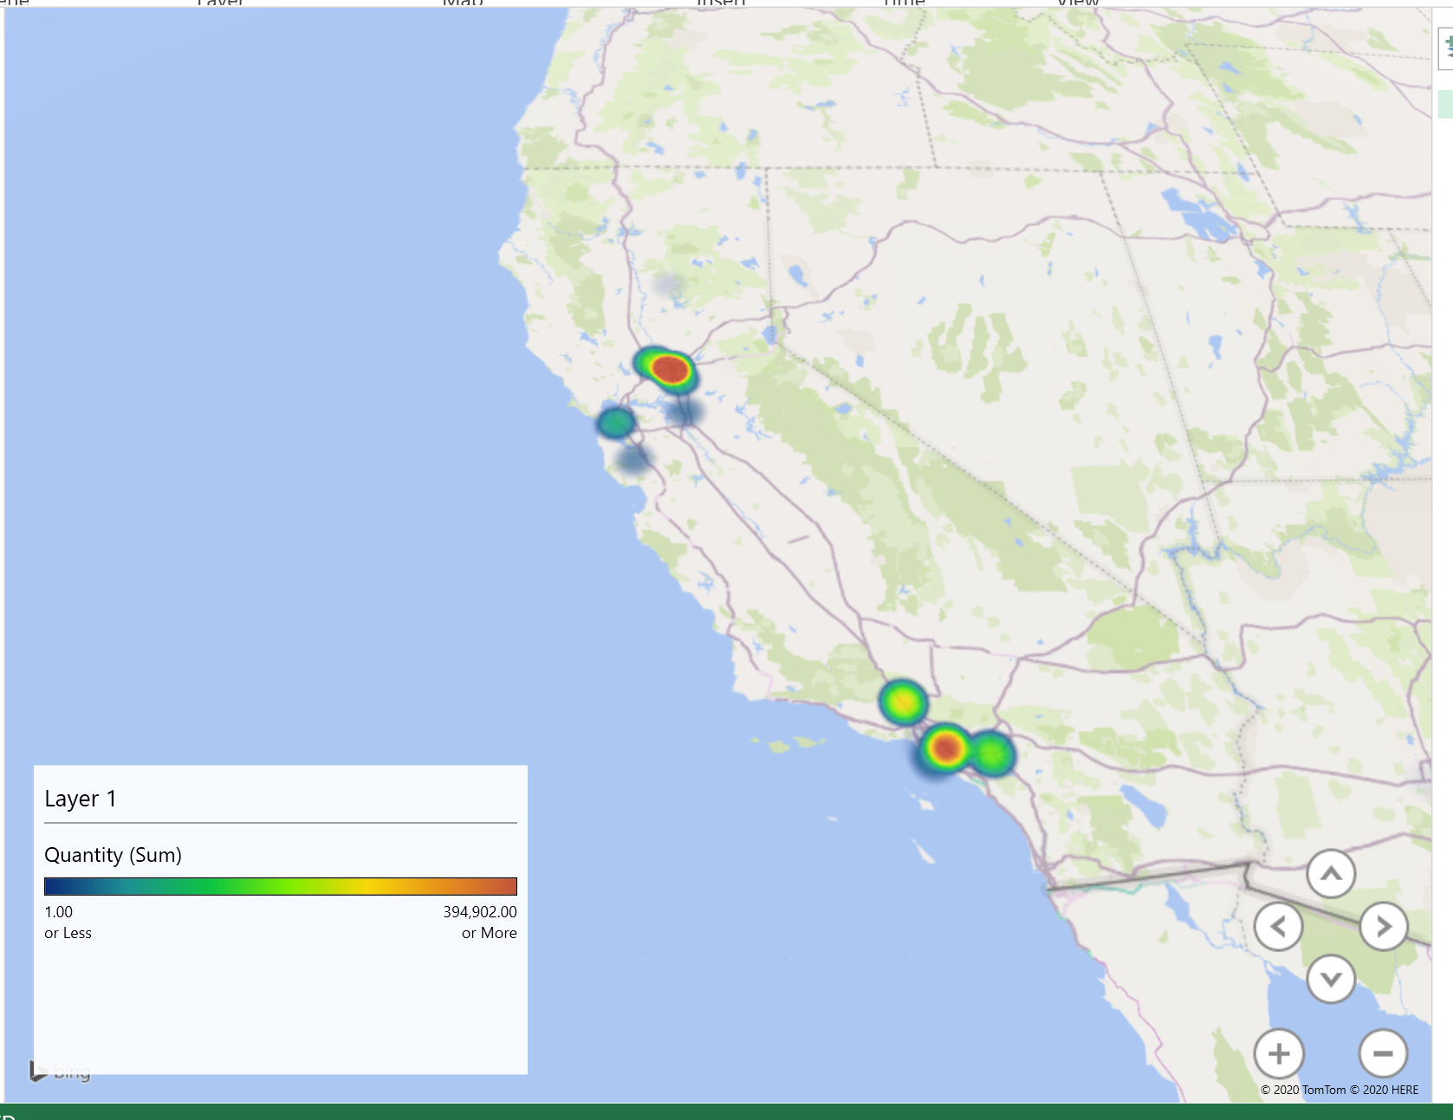
Result (Map)

Slide 9
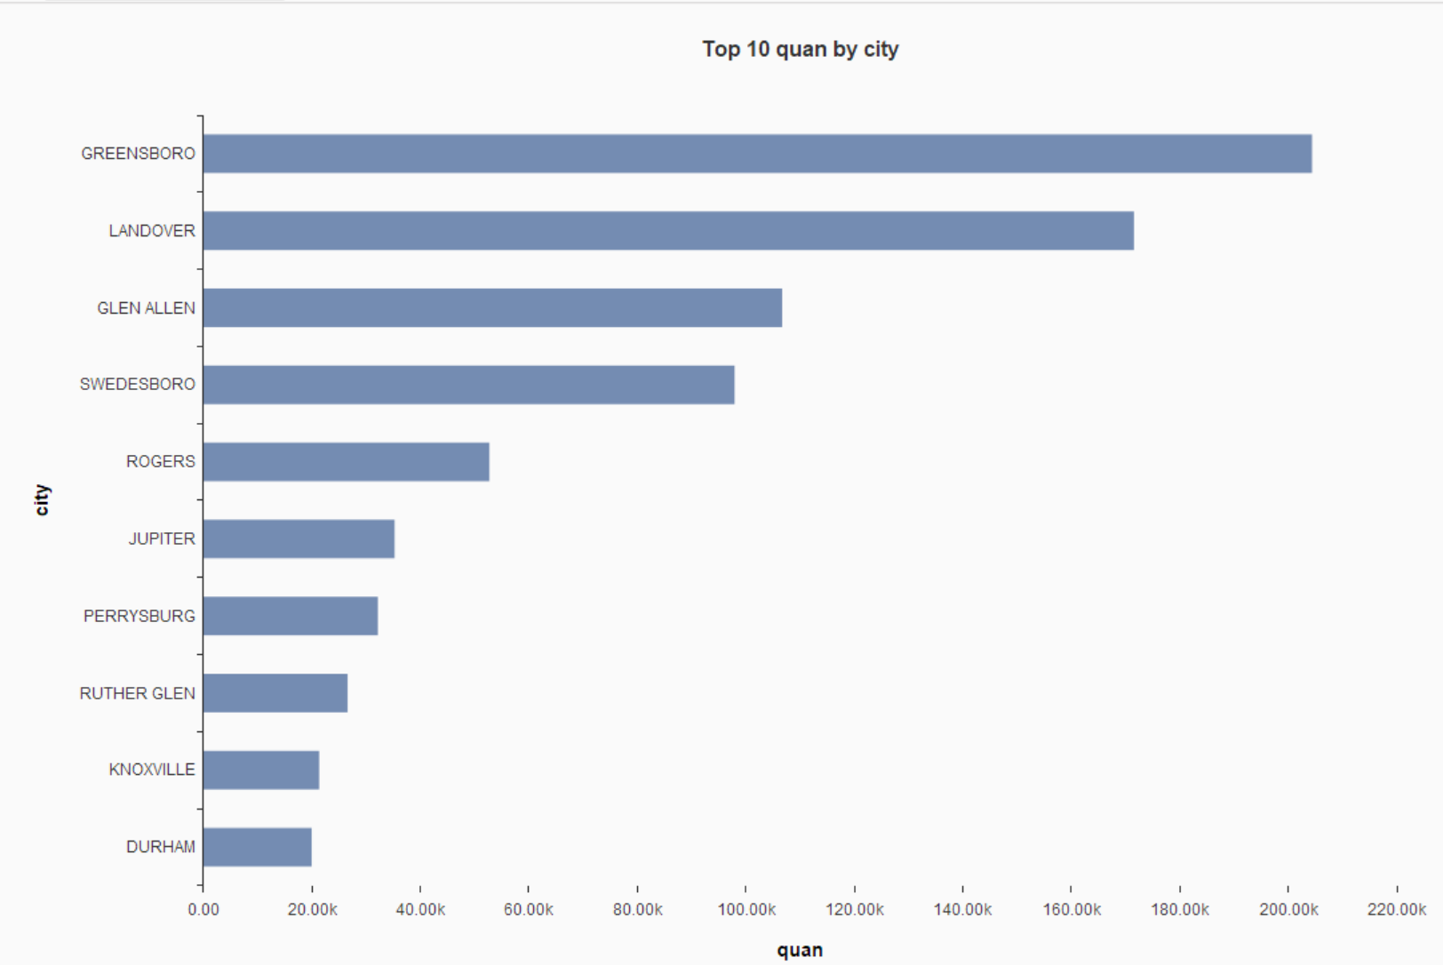

Slide 10
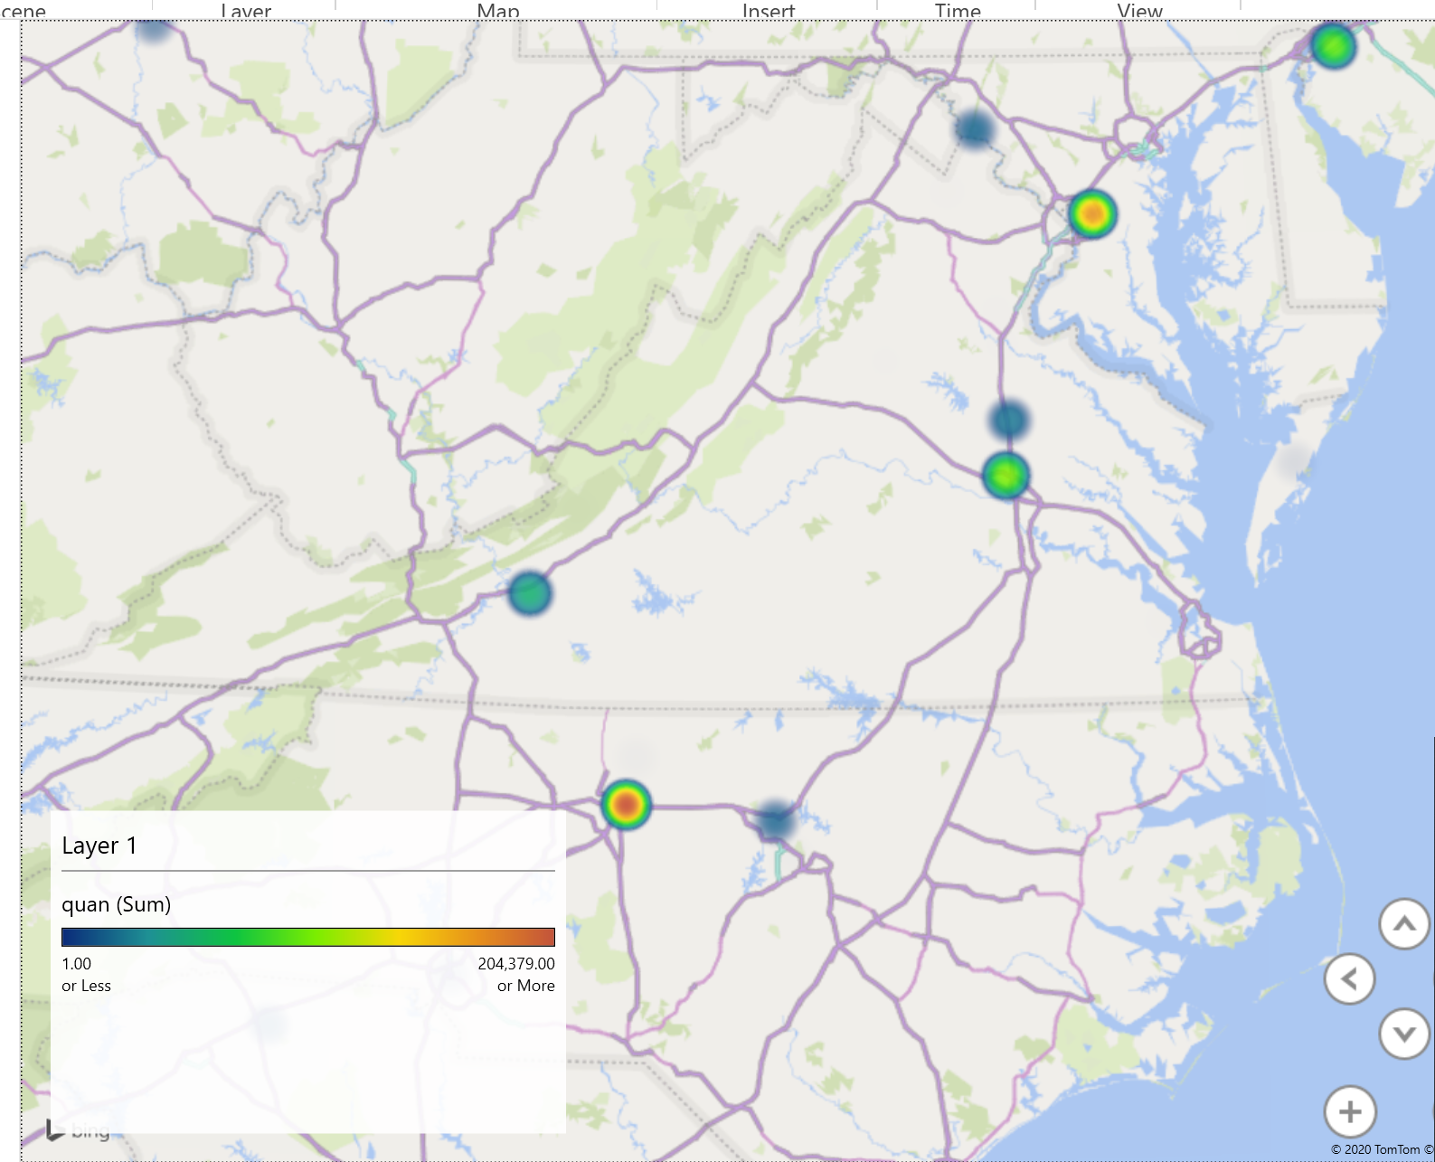
Top Distributed Cities (Virginia

Slide 11
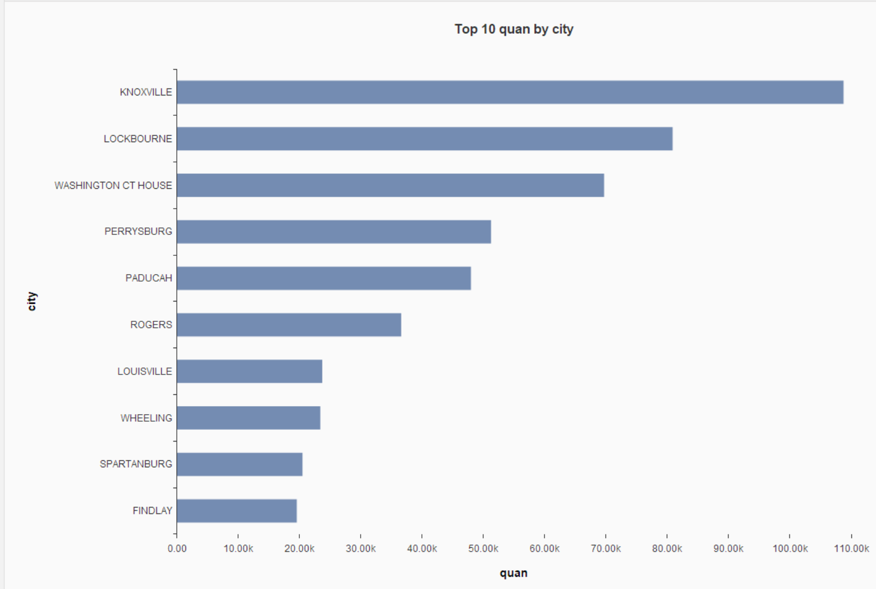

Slide 12
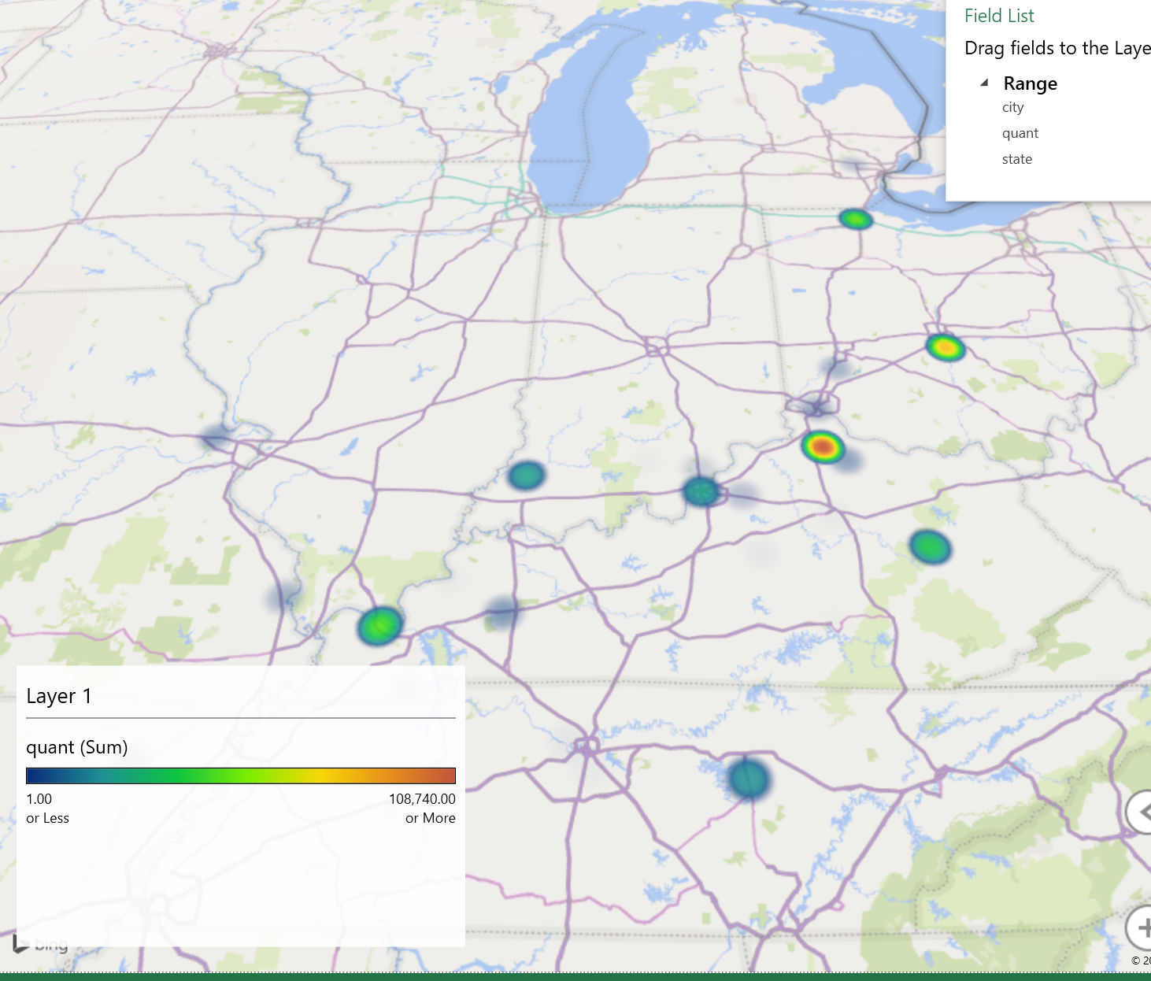
Top Distributed Cities (Kentucky)

